Slide 1
Why we need to think about SEO before and during project design rather than trying to bolt it on afterwards
Or what I learned from Hedgehog Books

Slide 2
What part do you play?
Designers
Navigation
Logo banner area
Room for critical keyword elements
Developers
Copy development and formatting
Code
Project managers or both
Url selection
Copy development
Continue keyword development for each page

Slide 3
What is the goal of SEO?
To convince Google your page deserves to be on top as determined by:
Authority
Content – lots of it, so design it to expand
Click thru – Title and description tags, CRO, placement of copy
Time on site
Shares, Likes, Tweets, +1
Include sharethis
Quality of content, spelling, etc.
No spam
Relevancy
Content
Time on page
Shares, Likes, Tweets
No spam
SEO tricks
KEYWORDS

Slide 4
Keywords
Keywords are to websites what a foundation is to a house.
So build your foundational design with this in mind.

Slide 5
Keywords
What is your goal?
To be pretty or to acquire customers?

Slide 6
Keywords
Ask customers to provide a list
Bring in an SEO consultant to help
Do it yourself
HOW? Google’s free keyword research tool
HOW MANY?
As many as budget allows.
As many a competition allows.

Slide 7
What to do with your keywords?
Placement is key
Urls
Top of page
Beginning of sentences
Beginning of paragraphs
Title tags
Link anchor text
Location words should be visible for local searches
Should not be in images!
Should be in images!
If you’re using Flash, provide text version for robots

Slide 8
What to do with your keywords?
URLS
Google is dialing exact match domain url points down, but they still work
Use SEF urls (keyword rich)
Eliminate dynamic page urls
Dashes between words

Slide 9
What to do with your keywords?
Title tags
Should include your target keywords
Should be unique
Keywords should come first
Should include your brand name at the end if you have a known, trusted brand
Should include the same words on the page
<title>San Jose insurance agent – Taylor Benefits</title>

Slide 10
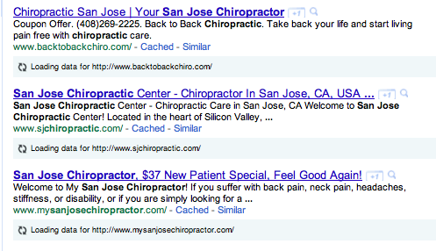
What to do with your keywords?
Description, keyword meta tags
Description is your call to action
No or little value for rank in Google

Slide 11
What to do with your keywords?
Links
Should include your target keywords and page it links to should be associated with keywords
Only first one on the page counts, so don’t overdo them
Pass page rank, particularly from home page
Should be text, not images

Slide 12
What to do with your keywords?
Images
Should have keywords in the name
Should have keywords in alt tags
Should have keywords in captions

Slide 13
What to do with your keywords?
H1, h2, etc.
Should have one H1 tag at the top of the page
H2, h3, etc. have little value
Bold little value
<emph> more value

Slide 14
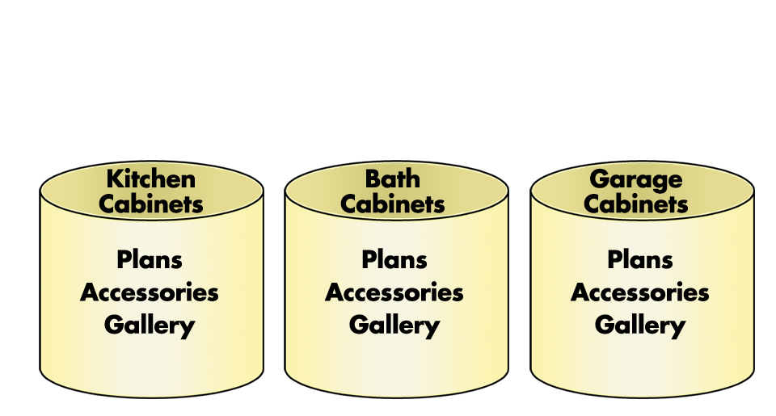
What to do with your keywords?
Architecture
Silos – Don’t be a Macy’s! Organize by category!
Pass page rank to the top level
Keep site “flat” with fewer nested directories

Slide 15
What to do with your keywords?
Content
Don’t keyword stuff
2-3 keyword targets per page, no more
Long enough copy to incorporate keywords and their variations, plus headings, to give enough weight to establish relevancy
Local considerations
Include address and phone number on each page in TEXT

Slide 16
Crawling, Indexing, & Other Technical Issues
Indexing
Meta Directives
<META NAME=“ROBOTS” CONTENT=“INDEX,FOLLOW”>
Robot files
Keep from crawling low quality pages
Keep from crawling duplicate copy
User-agent: *
allow: / (Means all the robots are allowed to crawl everything that comes under the root folder, which is the entire website)
User-agent: *
Disallow: /temp/ (Means all the robots are not allowed to crawl the folder named “temp”, while other parts are allowed to crawl)

Slide 17
Crawling, Indexing, & Other Technical Issues
Sitemaps
XML Sitemap
Submit to Google via Google Webmaster Tools
Free generator: http://www.xml-sitemaps.com/
HTML Sitemap on site
Create by hand and use keywords!
Good example: http://spiderbites.nytimes.com/
Sitemaps help indexing of blogs and dynamically created pages

Slide 18
Crawling, Indexing, & Other Technical Issues
301 Redirects & 404’s
Run site:http://www.domain.com to get list of urls in site
Make sure new site has the same urls
Look for 404s in Webmaster tools
Where different, create 301 redirects in .htaccess file
Redirect 301 /oldpage.php /newpage.php

Slide 19
Crawling, Indexing, & Other Technical Issues
Load time
Not much weight, but still important
Check in Webmaster Tools under “Labs”

Slide 20
Crawling, Indexing, & Other Technical Issues
Canonicalization & Duplicate Content
Canonicalization is the process of using and enforcing the best URL when there are several choices
These urls are all different:
www.example.com
Example.com
www.example.com/
Example.com/
www.example.com/index.html

Slide 21
Crawling, Indexing, & Other Technical Issues
Canonicalization & Duplicate Content
Why be concerned about duplicate content?
Duplicate content can dilute PageRank
Your site can be banned from Google
Links going to “duplicate pages” instead of the same are weakened
Multiple domain names create duplicate content for every page on the site!
Dynamic sites often inadvertently create duplicate content

Slide 22
Crawling, Indexing, & Other Technical Issues
Canonicalization & Duplicate Content
How to fix it:
Limit crawling of duplicate pages where possible (i.e. use no-follows, or pull-down forms for sorting)
Use Permalinks or SEF Urls
Pick one “canonical” url and link consistently throughout your site
Make all non-canonical urls do a permanent 301 redirect to preferred urls
Specify www vs. non-www in Webmaster Tools

Slide 23
Crawling, Indexing, & Other Technical Issues
Canonicalization & Duplicate Content
How to fix it:
Add canonical tag at page level
On http://www.example.com/page.html?sid=asdf314159265
<head>
...
<link rel="canonical" href="http://example.com/page.html"/>
...
</head>
(Don't forget the final / at the end of the link tag.)

Slide 24
Other Technical Considerations
Avoid javascript or flash for menus or make sure there is an alternative
Avoid extraneous html
Javascript and css should be in external files

Slide 25
User Signals
Google uses user signals to determine how much trust to give a site

Slide 26
User Signals
Click thru
Create great title and description tags
Your description is your elevator speech

Slide 27
User Signals
Bounce
Make sure page is relevant to the keyword you are targeting
Make sure they can see that RIGHT AWAY!
Check analytics, look for bounces, CORRECT!

Slide 28
User Signals
3. Time on site
Answer: Why am I here? What am I supposed to do?
Make it easy to read and see that the site is relevant
Bullets
Short paragraphs
Informative headings
Call to action – Lead them INTO the site
Put “catchy” content where they look (See F-Heatmap)

Slide 29
User Signals

Slide 30
Ecommerce
PROBLEM: Ecommerce sites generally full of duplicate content. How do you make yours unique?
Reviews
Related products
Custom descriptions
http://www.seomoz.org/blog/building-faceted-navigation-that-doesnt-suck

Slide 31
DON’Ts
DON’T provide different content to search engines and humans
DON’T try to trick search engines to improve rankings
DON’T use hidden or extremely small text
DON’T keyword stuff
DON’T use same title tags
DON’T copy content

Slide 32
DON’Ts
DON’T spam your credits
CAREFUL! could result in penalty
THIS

Slide 33
FINAL DON’T– Don’t make the mistake of thinking that pretty is enough.
Pretty may get you a wink, but not necessarily a relationship.

Slide 34
Need help?
Kat & Mouse takes your site to the next level with:
Website & Google Places optimization to get Google to take note
Link building to move your site above the competition
Social Media marketing – Custom landing pages, engagement, website integration to get people singing your praises
Mobile Marketing to capture the crowd on the street in the new internet
Monthly monitoring and improvements to keep you on top

Slide 35
Kat & Mouse
Please connect with me
www.katandmouse.com
anonymouse@katandmouse.com
408-694-3706
www.facebook.com/katandmouseo
Twitter: @katndmouse
LinkedIn - Kathy Long
LinkedIn: Join Local BizBuzz Group http://www.linkedin.com/groups/Local-BizBuzz-3215677
To your success!

